Slide 1
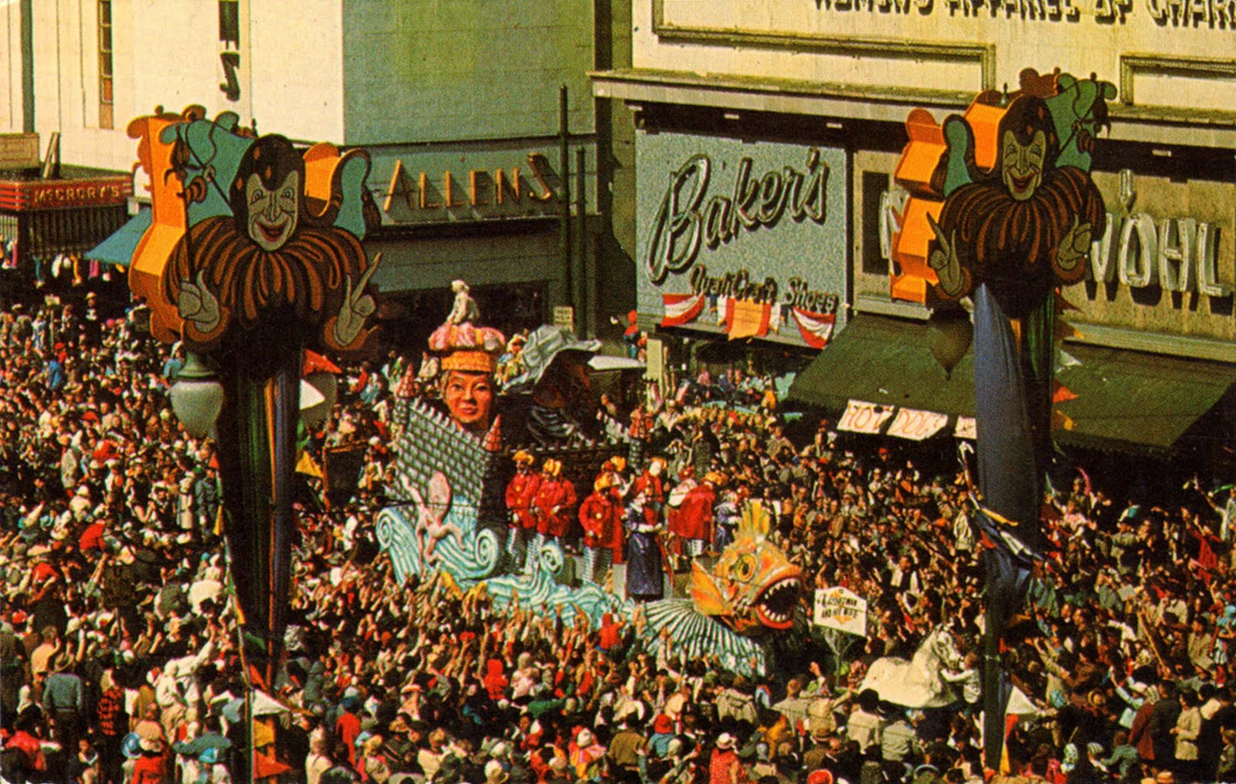
EXCELlent Instructional Strategies
Common Core Math & Financial Literacy
More Real World In What We Teach!

Slide 2


“THROW ME SOMETHING MISTER”
Notes:
THROW ME SOMETHING MISTER!!! Describe Mardi Gras parades. Audience instructed to shout out this quote when they see one of these firecracker displays.

Slide 3
TODAY’S GOALS
Who Is Presenting!
Andrew J. Nelson
Math Teacher, Granada Hills Charter High School
Lead Teacher, Global Business & Finance Program
24 Year Career As Entrepreneur & Economist
B.A., M.A. Economics U.S.C.
M.A. Education Pepperdine University

Slide 4

TODAY’S GOALS
What We Will Do!
Overview of CA Common Core Math Standards
EXCEL’s Alignment To Common Core
Highlight EXCEL Strategies For Instruction & Assessment
EXCEL Applications & CTE Business Pathway

Slide 5

TODAY’S GOALS
What We Won’t Do!
Exhaustive Treatment of Common Core Standards
Click-By-Click EXCEL Instruction

Slide 6
EXCEL IN THE CLASSROOM
Traditional Applications
Notes:
Traditional applications of Excel in projecting future streams of income. Commonly used in classroom instruction that aligns with

Slide 7
EXCEL IN THE CLASSROOM
Traditional Applications
Function Library
Notes:
Excel Function Library offers a wealth of cross curricular tie-ins. Today, we concentrate on business applications, but you will get a feel of how many possible curricular uses are possible.

Slide 8
EXCEL IN THE CLASSROOM
Traditional Applications
Function Library
Design of Curriculum
Notes:
After examining financial functions, we’ll look at a few elements of EXCEL that can help teachers design curriculum. Every aspect of teaching can incorporate Excel including core instruction, assessment, differentiation, and engagement.

Slide 9
EXCEL IN THE CLASSROOM
Traditional Applications
Function Library
Design of Curriculum
Links Simulate A Web Site
Notes:
Excel allows users to create links that are identical to those found on the web. This feature has permitted me to develop self-contained lesson modules. We’ll talk briefly about how this feature can enhance student learning.

Slide 10
EXCEL IN THE CLASSROOM
Traditional Applications
Function Library
Design of Curriculum
Links Simulate A Web Site
Non-Math Applications
Notes:
I am convinced that Excel features can be incorporated in all content areas. To wrap up, we’ll look at a few experimental applications in an English context. These discussions open an interesting inquiry into the cognitive connections of similarity for teaching English and Math.

Slide 11
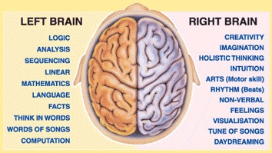
DEDUCTIVE VS. INDUCTIVE
GOD GAVE US TWO SIDES FOR A REASON!
REAL WORLD SKILLS USE BOTH SIDES OF THE BRAIN

Slide 12
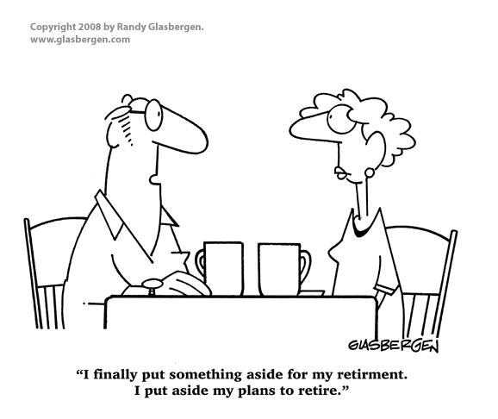
Notes:
This cartoon largely preaches to the choir. We’re here because we are committed to bringing more real world experiences into the classroom. Educational trends are leading away from teaching theory, theory, and more theory. On the other hand, we don’t want to devolve back to a world where business education is a remedial instruction with little academic theory and simply a trade program for underachievers. We as educators must connect theory and application. For it is through this marriage of theory and application that we develop SKILLS that will serve our students in the competitive 21st century economy.
And yes they did misspell “retirement”.

Slide 13
FINANCIAL LITERACY &
EXCEL INSTRUCTION
Notes:
Traditional applications of Excel in business.

Slide 14
FINANCIAL LITERACY STANDARDS
“Students in the Business Financial Management Pathway learn to provide investment analysis and guidance to help businesses and individuals with their investment decisions. Students learn that exploring, applying, and monitoring investment opportunities are necessary to take advantage of financial opportunities throughout one’s life.”
BFM STANDARDS: Link & Text In Your Package

Slide 15
SAMPLE PATHWAY STANDARD
STUDENTS CREATE AND USE BUDGETS TO GUIDE FINANCIAL DECISION MAKING:
“Create a budget to calculate long-term projections.”
“Analyze past and current budgets to determine financial business needs.”

Slide 16
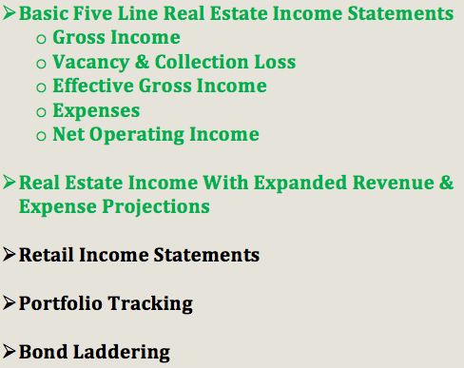
Traditional EXCEL Instruction
Financial Literacy

Slide 17
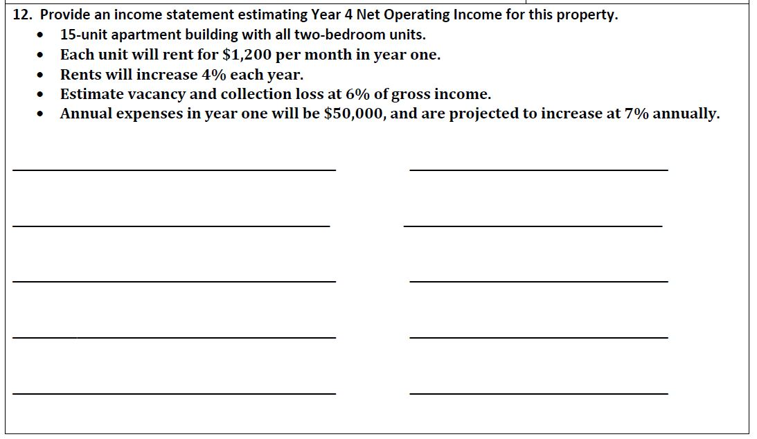
Real Estate Income Statements
Complex Calculations Using Basic Operations
Copy In Your Package
Notes:
Originally what Excel was designed to do. (MY EARLY EXPERIENCES WITH FIRST IBM PCs)

Slide 18
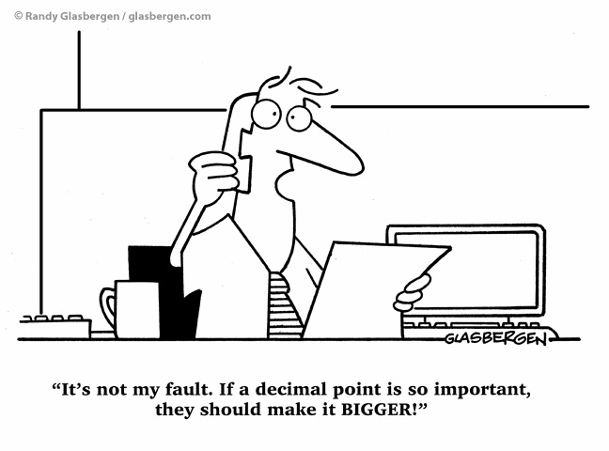

Slide 19
EXCEL
&
SCAFFOLDING
Supporting Students With Weak Computational Skills
Notes:
THROW ME SOMETHING MISTER!!!

Slide 20
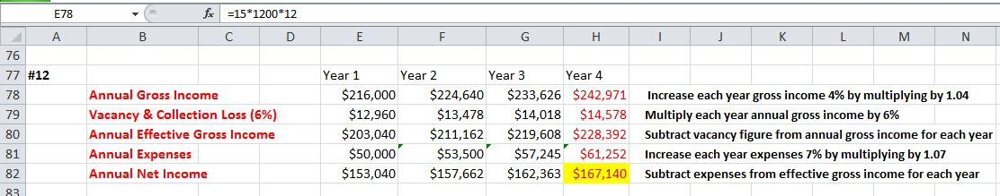
EXCEL Worksheets
Scaffolding Complex Computations
Copy In Your Package
INSTRUCTION
ACCOUNTING STRUCTURE & VOCAB
Notes:
The choice of apartment buildings ties into most students’ prior knowledge. Little time is spent providing background as to categories of income and expense. Students can focus on simply memorizing basic accounting terms and their sequence and arithmetic relationships in an income statement. In contrast, ff we starte with a retail income scenario, much explication would be required to describe how a retail business operates (e.g. “cost of goods sold”).

Slide 21
EXCEL Worksheets
Scaffolding Complex Computations
CELL BY CELL REVIEW: Gridlines Create Structure
COMPACT: Computations Reviewable In Context
Notes:
Each computation can be reviewed step by step. Gridlines create structure which benefits metacognitive absorption and organization of the arithmetic procedures. A compact design allows far more computations to be fit on a single page. This compact design element allows students to see how the individual computation fits into the context of the problem at hand.

Slide 22
EXCEL Worksheets
Scaffolding Complex Computations
CLEAR PATTERNS: Fewer Neurons Required
Linking Deductive & Inductive Reasoning
Notes:
With EXCEL’s compact design, students will more easily recognize patterns of calculation, and thereby fewer cognitive links will be required to learn the 20 computations that make up the complex task shown. Viewing the pattern of how EXCEL records each cell’s instructions allows students to replicate neural programming of previous performed computation rather than memorizing each computation separately. In practice, students quickly advance to using EXCEL’s copy tool to replicate these patterned computations. In this way, EXCEL’s design matches metacognitive programming.

Slide 23
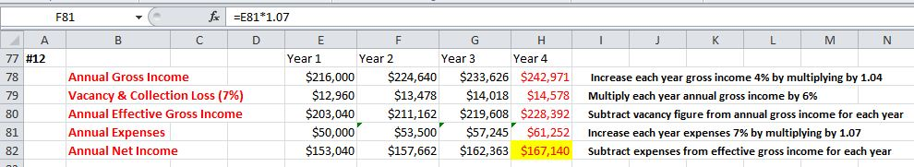
EXCEL Worksheets
Scaffolding Complex Computations
STUDENT-CENTERED PACING: Their Speed, Their Location
DELIVERY: Fits “Flipped” Classroom & Other Strategies

Slide 24
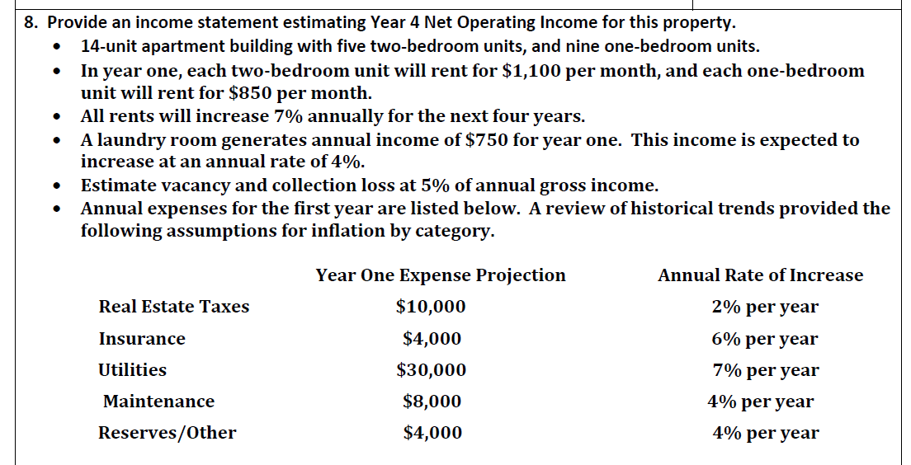
Intermediate Income Projections
More Complex Calculations
Copy In Your Package
Notes:
The next step now expands the cash flow analysis to incorporate multiple sources of income (one bedroom units, two bedroom units and laundry income); and expenses (real estate taxes, insurance, utilities, maintenance, and reserves.) At this point, instruction can be expanded to include modeling of expense functions using historical data or application of algebraic procedures (e.g. utility costs = $fixed amount + $variable * number of units).

Slide 25
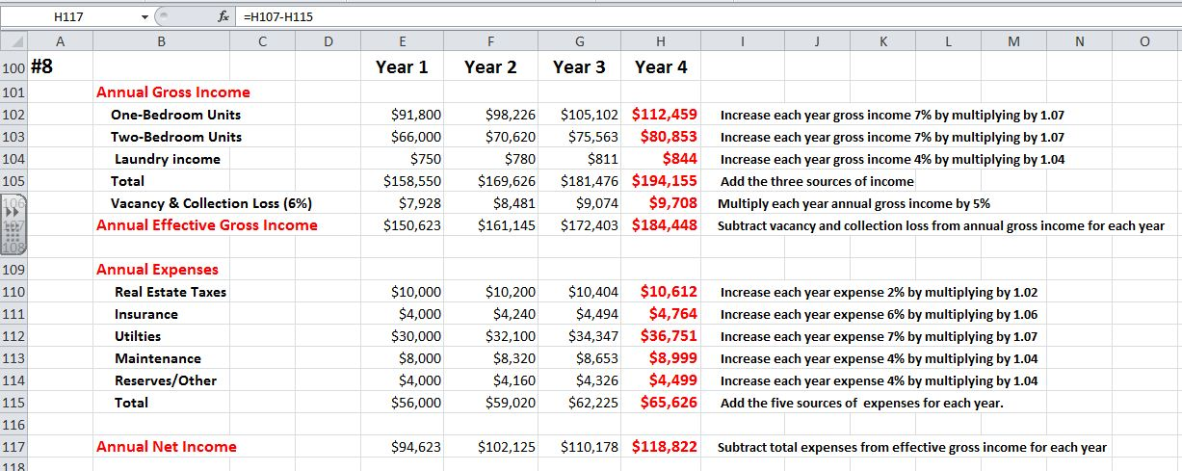
Intermediate Income Projections
More Complex Calculations
INSTRUCTIONAL WORKSHEET: Copy In Your Package
Notes:
At this point, student work starts to resemble the level of detail performed in the valuation of small apartment buildings. A project can be assigned where students select an apartment building in their neighborhood then perform a cash flow analysis for the building.

Slide 26

EXCEL
ALIGNS WITH
COMMON CORE

Slide 27
WHY EXCEL
ALIGNS WITH COMMON CORE MATH
Microsoft
Profit Incentive
Common Core
Educational Goals
ALIGNMENT
REAL WORLD APPLICATIONS OF MATH
Notes:
As I integrated my Business Statistics course with Excel, it became clear why Excel so closely aligned with the Common Core math standards. Microsoft seeks to maximize sales of Office Suite by finding applications that their customers want and need. State education leaders are pursuing goals that will better prepare students to apply math skills in the real world scenarios. The confluence of these parallel goals leads to an amazing degree of alignment between Excel and CA’s Common Core.

Slide 28
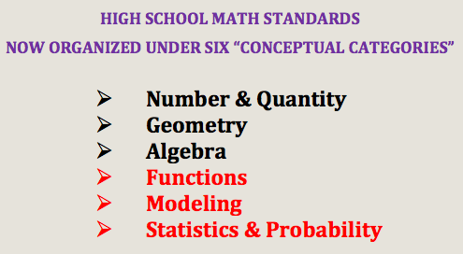
CALIFORNIA COMMON CORE MATH
Notes:
We previously saw some traditional uses of Excel in business instruction. Let’s move now to see how Excel can be used in some other areas of math instruction. Remember we’ll finish with looking at Excel in some non-numeric English class applications.
The Math Common Core explicitly recognizes that math instruction must evolve toward more real world applications and away from rote abstract calculations.

Slide 29
CALIFORNIA COMMON CORE MATH
“These Standards are not intended to be new names for old ways of doing business. They are a call to take the next step.“
Page 5 CCSS for Mathematics
Notes:
We previously saw some traditional uses of Excel in business instruction. Let’s move now to see how Excel can be used in some other areas of math instruction. Remember we’ll finish with looking at Excel in some non-numeric English class applications.
The Math Common Core explicitly recognizes that math instruction must evolve toward more real world applications and away from rote abstract calculations.

Slide 30
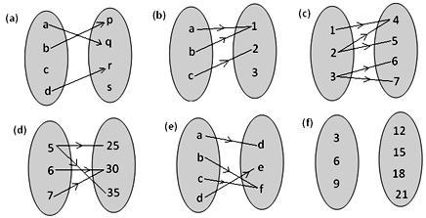

EXCEL
&
FUNCTIONS

Slide 31
FUNCTIONS IN ABSTRACT
“OLD” STAR TEST QUESTION
LACKS A CONTEXT
Notes:
Which is a function? Answer is “e” by the way. This question attempts to isolate a student’s understanding that a function must have a single output for every possible input.

Slide 32
VISUALIZING FUNCTIONS
CUTE & HELPFUL, BUT NOT REAL WORLD
Notes:
Here you see a “function machine”. Visuals such as this cute guy are commonly used to illustrate the concept of a function, inputs lead to an output.

Slide 33
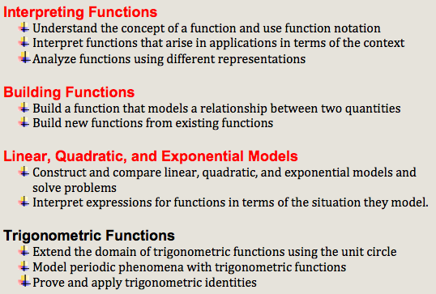
FUNCTION DOMAINS
Source: Page 56, K-12 California’s Common Core For Mathematics Updated 8/30/2012
Notes:
We begin with functions. Here the domains for “Functions” are summarized. Excel offers instructional tools that make functions more concrete. Average and below average students really benefit from Excel’s function input screens that scaffold the evaluation process. The next series of slides show how I sequence instruction from the basic concept of a function to advanced applications that reflect financial analysis comparable to that performed in first college finance courses. I will also highlight the instructional advantages of Excel.

Slide 34

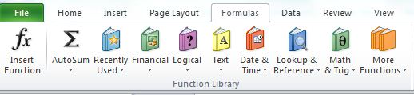
SAMPLE FUNCTION STANDARD
FUNCTION Concepts Made MORE CONCRETE
Notes:
EXCEL deepens students’ conceptual understanding of a function. Inputs and output are more concrete, and students can directly connect their classwork with future needs. Evaluation of functions emphasizes two skills: first, the selection of an appropriate output function to match real world scenarios; and second, proper identification of the inputs necessary to evaluate the output function. Use of current technology eliminates much of the tedious, time-consuming calculations that only demonstrate a student can apply PEMDAS using a calculator. These time savings lead to more complex financial applications with multiple inputs.

Slide 35
SAMPLE FUNCTION STANDARD
REAL WORLD TOOLBOX OF APPLICATIONS
EXCEL’S FUNCTION LIBRARY
Notes:
EXCEL deepens students’ conceptual understanding of a function. Inputs and output are more concrete, and students can directly connect their classwork with future needs. Evaluation of functions emphasizes two skills: first, the selection of an appropriate output function to match real world scenarios; and second, proper identification of the inputs necessary to evaluate the output function. Use of current technology eliminates much of the tedious, time-consuming calculations that only demonstrate a student can apply PEMDAS using a calculator. These time savings lead to more complex financial applications with multiple inputs.

Slide 36
SAMPLE FUNCTION STANDARD
FUNCTIONS IN CONTEXT Deemphasizes Abstract Derivation
Notes:
EXCEL deepens students’ conceptual understanding of a function. Inputs and output are more concrete, and students can directly connect their classwork with future needs. Evaluation of functions emphasizes two skills: first, the selection of an appropriate output function to match real world scenarios; and second, proper identification of the inputs necessary to evaluate the output function. Use of current technology eliminates much of the tedious, time-consuming calculations that only demonstrate a student can apply PEMDAS using a calculator. These time savings lead to more complex financial applications with multiple inputs.

Slide 37

EXCEL
&
DIFFERENTIATION
LEARNING IN STAGES: Breaking Down Complexity

Slide 38
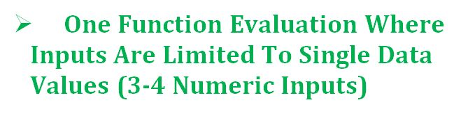
Staged Function Instruction
Three-Step Progression

Slide 39
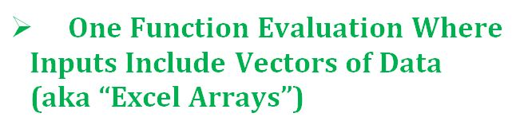
Staged Function Instruction
Three-Step Progression

Slide 40
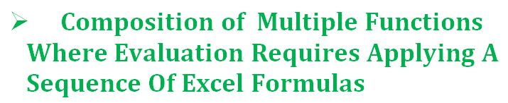
Staged Function Instruction
Three-Step Progression
Notes:
Students progress at their own pace through the three stages. Some can reach proficiency in a matter of weeks. Others require more than a semester.

Slide 41
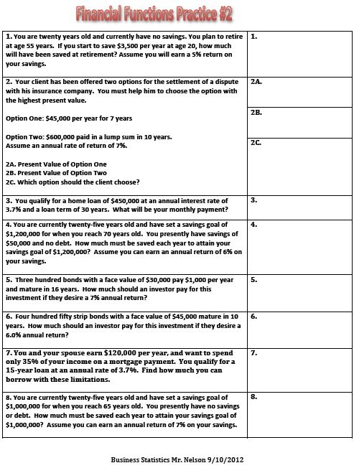
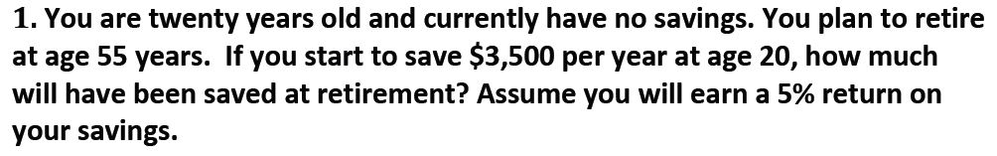
SAMPLE ASSESSMENT: Copy In Your Package
Notes:
Next slide should be a zoom in on question #1.

Slide 42
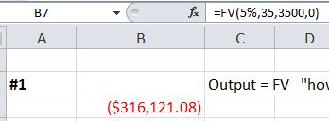
EXCEL Formula Windows
Reinforce Function Notation
FUNCTION NOTATION
Notes:
Notice how every formula calculation is presented in the toolbar in function notation.

Slide 43
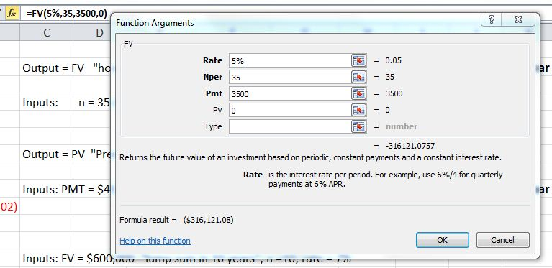
EXCEL Function Windows
Make Inputs & Outputs Concrete
OUTPUT: Future Value (FV)
INPUTS: (3-4 Numeric Variables Required)
Notes:
Notice how inputs and output are more concrete. Students understand that a function has a purpose. Traditional instruction in abstract leaves average and below average students behind. They never connect a context to the function.

Slide 44
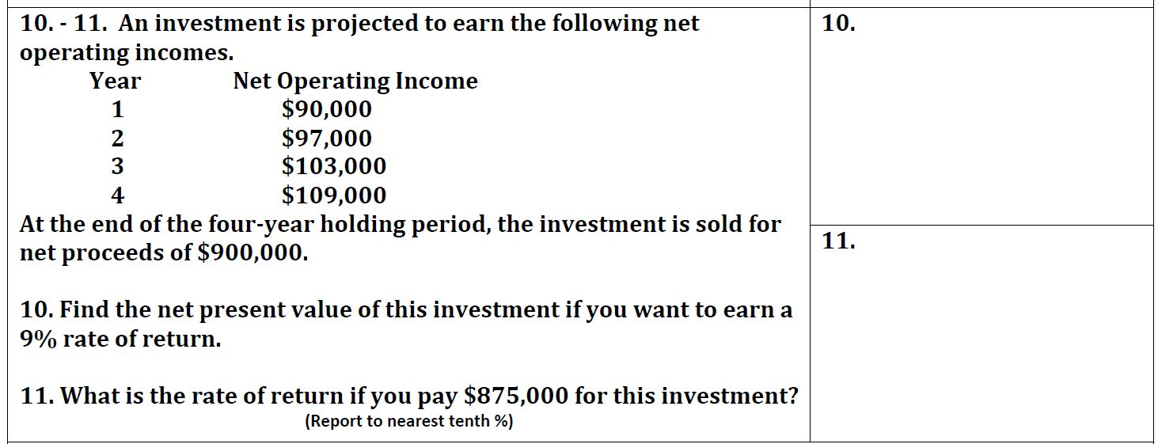
VECTOR: Set of Four Numbers Input For A Variable
Notes:
Abstract instruction in vectors often lacks any real world application of a vector. Here students have a concrete example. They can directly observe how Excel treats an ARRAY of numbers as a single input. Even below average math students develop an understanding of an advanced math concept, and more importantly can use a vector of values in a real world context.

Slide 45
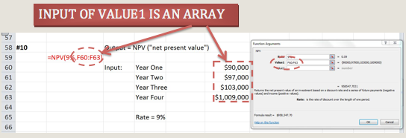
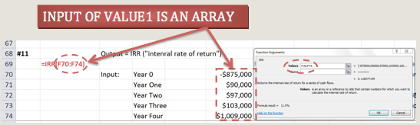
EXCEL Data Arrays
Make Vectors Concrete
COPY IN YOUR PACKAGE

Slide 46
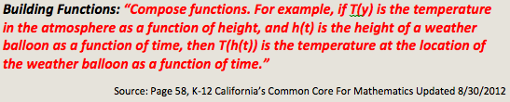
SAMPLE FUNCTION STANDARD
Notes:
EXCEL enables students to better understand the composition process that can be missed when presented in a solely abstract manner. Composition is taught with more realistic multivariate contexts. The Common Core composite function example considers a single input variable, time. Financial functions commonly use a variety of input combination selected from number of periods, rate, present value, future value and payment.

Slide 47
Standard Considers Just One Input Variable (Time)
Next Sample Question Considers Three Inputs
MORE REAL WORLD CONTEXT!
Notes:
EXCEL enables students to better understand the composition process that can be missed when presented in a solely abstract manner. Composition is taught with more realistic multivariate contexts. The Common Core composite function example considers a single input variable, time. Financial functions commonly use a variety of input combination selected from number of periods, rate, present value, future value and payment.

Slide 48
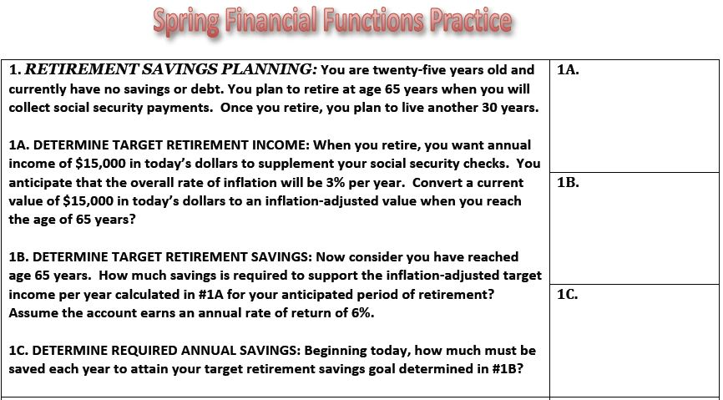
EXCEL Provides Structure
Multivariate Composite Functions
SAMPLE COMPOSITE ?#1: Copy In Your Package

Slide 49
SEQUENCING FUNCTIONS Is A Challenge
Output of f is an input of g
Output of g is an input of h
Notes:
Understanding composite functions is understandably challenging for most students. To absorb the process in abstract can be daunting for many students. Traditional composite function notation shown at the bottom of the page is certainly not help most students who find the sequencing of functions difficult.
This sample problem is a more difficult application of composite functions than that typically taught in a high school Algebra course, and reflects a skill that would be present in first year college finance class. Notice the output of function f is a FV but is input as a PMT in function g. The output of function g is a PV though it is used as a FV in function h. This greater complexity is overcome by most of my students because of the real world context of the problem. They can visualize the timeline involved, and with enough support and time they do master of this REAL WORLD application of composite functions.

Slide 50
EXCEL Provides Structure
Multivariate Composite Functions
QUESTION DESIGN: Scaffolding The Sequence
FUNCTION #1: Adjusting For Inflation
Notes:
When students are first introduced to composite functions,

Slide 51
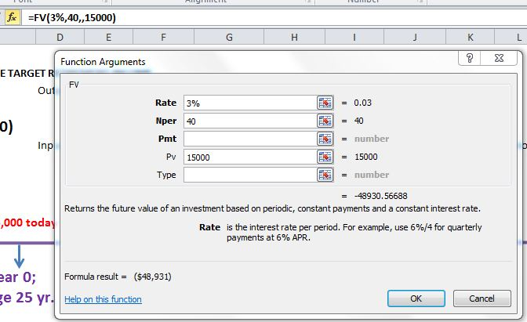
INPUTS
OUTPUT
Students must select the “Future Value (FV)” output formula and
evaluate it using three inputs (rate, number of periods, and present
value). The result is a future value = $48,931.

Slide 52
EXCEL Provides Structure
Multivariate Composite Functions
FUNCTION #2: Find Target Savings
Notes:
When students are first introduced to composite functions,

Slide 53
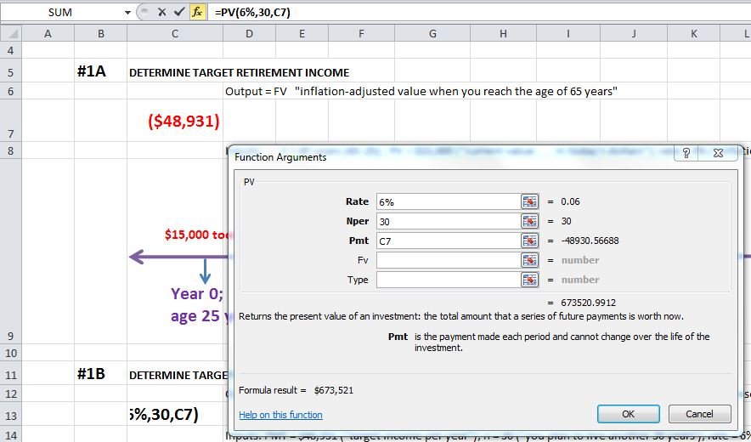
OBSERVABLE TRANSITION: Output To Input
Observe Output Becoming Input
Students must select the “Present Value (PV)” output function and
evaluate it using three inputs (rate, number of periods, and payment). The result is a present value = $673,527.
Notes:
Notice how the $48,631 now becomes an input into the next function. Greater difficulty reflected in students needing to recognize this future value output now becomes a payment input into the second function in the sequence.

Slide 54
EXCEL Provides Structure For
Multivariate Composite Functions
FUNCTION #3: Find Annual Savings
Notes:
When students are first introduced to composite functions,

Slide 55
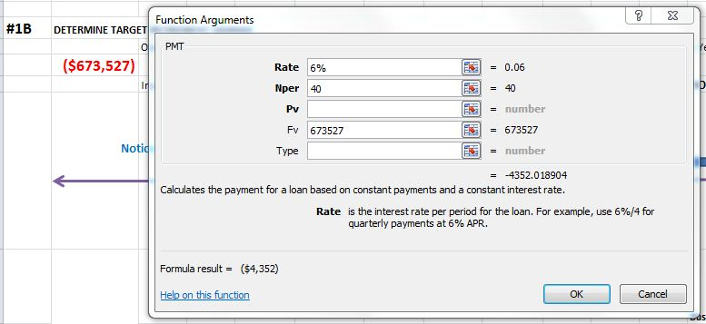
Observe Output Becoming Input
Students must select the “Payment (PMT)” output function and
evaluate it using three inputs (rate, number of periods, and future value). The result is a payment = $4,352.

Slide 56

EXCEL
Connecting To A Business Context

Slide 57
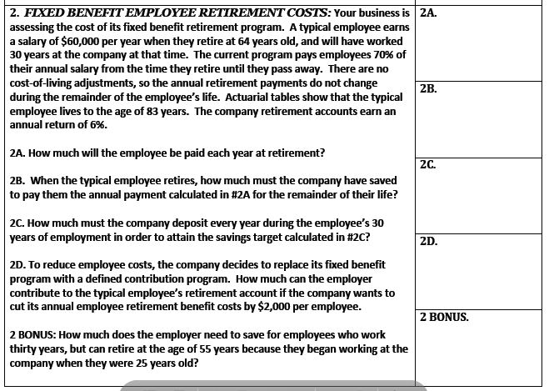
SAMPLE COMPOSITE ?#2: Copy In Your Package
Notes:
The next composite function mixes financial functions with simple arithmetic functions. This mixture mirrors most real world financial applications, and synthesizes a student’s prior knowledge of mathematical procedures learned earlier in their primary and secondary math curriculums.
For time sake, we won’t walk through the calculations but just point out a few elements of question design.

Slide 58
FUNCTION #1: (Multiplication)
Notes:
The next composite function connects student’s understanding of personal finance with a current topic in business (Fixed Benefit Retirement programs versus Contributory Retirement programs) It also mixes financial functions with simple arithmetic functions. This mixture mirrors most real world financial applications, and synthesizes a student’s prior knowledge of mathematical procedures learned earlier in their primary and secondary math curriculums.

Slide 59
FUNCTION #2: Present Value

Slide 60
FUNCTION #3: Payment

Slide 61
FUNCTION #4: Subtraction

Slide 62
BONUS FOR ADVANCED STUDENTS
Students Must Determine
Sequence of Composite
Notes:
Bonus is an example of enhanced instruction for advanced students. Scaffolded structure of question guides students through sequence of functions and connects with prior knowledge of financial functions learned in the first semester.

Slide 63

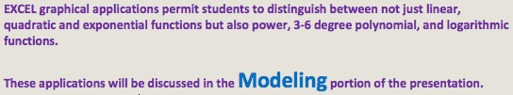
SAMPLE FUNCTION STANDARD
Notes:
Lots you can do with linear, quadratic & exponential models. We’ll comment just briefly in the modeling section near the end of the presentation.

Slide 64
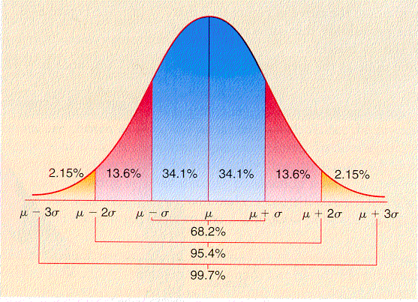
EXCEL
&
STATISTICS
Notes:
More Slides Like This One We Need. “Differentiated Instruction With EXCEL”; “Assessment With Excel”; “Modeling With Excel”; “Functions With Excel”; “Graphic Organizers With Excel”; Maybe use different colors besides red.

Slide 65
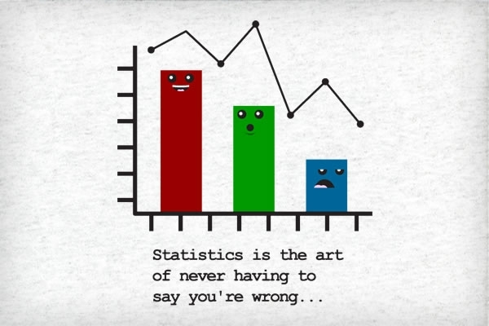

Slide 66
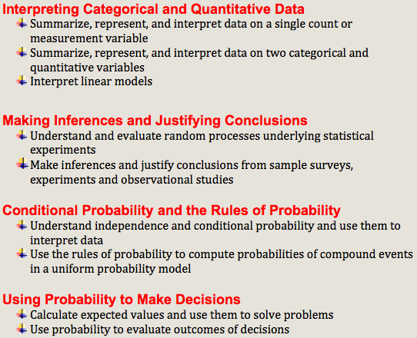
STATISTICS & PROBABILITY DOMAINS
Source: Page 67, K-12 California’s Common Core For Mathematics Updated 8/30/2012
CORE STANDARDS: Link & Text In Your Package
Notes:
Here, we’ll take a few quick glimpse at how I integrate Excel into common core domains for statistics and probability.

Slide 67

EXCEL &
STUDENT
ENGAGEMENT
INTEGRATE ART & MATH: BUT Keep The Focus On Math
Notes:
More Slides Like This One We Need. “Differentiated Instruction With EXCEL”; “Assessment With Excel”; “Modeling With Excel”; “Functions With Excel”; “Graphic Organizers With Excel”; Maybe use different colors besides red.

Slide 68
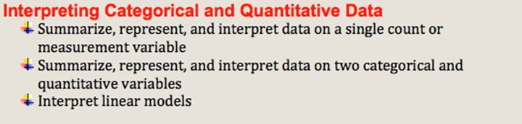
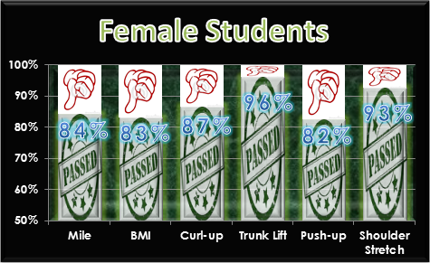
STUDENT WORK
CATEGORICAL Variables: Compare Proportions
Notes:
Excel enables students to create visually inspiring graphic displays that demonstrate a deep knowledge of the underlying statistics. Incorporation of an artistic element engages the marginally interested students while enhancing the communication of the statistical concepts. These displays document student learning more broadly than most summative tests. In contrast to most hand drawn art projects I’ve used, students spend 80% of their time on the math and 20% on the artistic elements.

Slide 69
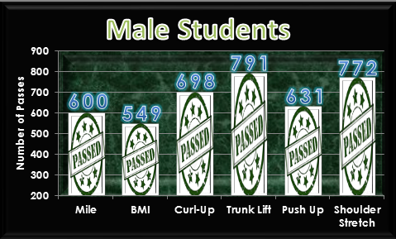
QUANTITATIVE Variables: Contrast Frequency Counts
STUDENT WORK
Notes:
This graphic display was created for the PE Department. We analyzed their 2012 Fitnessgram test results.

Slide 70
STUDENT WORK
TIME SERIES: Bivariate Data Analysis
Notes:
At first, it takes students an hour plus to prepare a graphic display such as this one. By the end of the semester, nearly all of my 175 students can embellish a graphic display in 10 to 15 minutes or less.

Slide 71
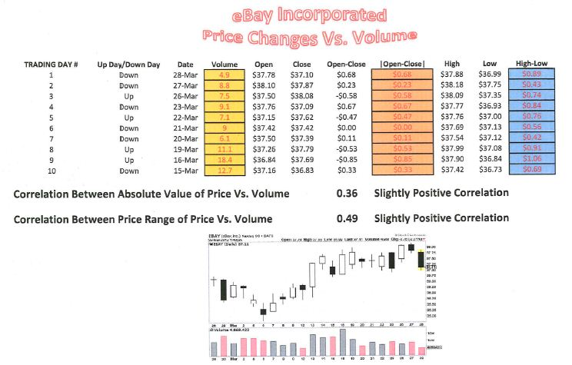
CORRELATION:
Are high sale volumes positively
correlated with price volatility?
STUDENT WORK
Notes:
Some stock market analysts profess that a relationship exists between sales volume and price volatility. We learn how standard terms in statistics such as “spread” are often expressed with a different jargon in some industries. Students learned about candlestick charts as well.

Slide 72
EXCEL
&
PROBABILITY
Notes:
More Slides Like This One We Need. “Differentiated Instruction With EXCEL”; “Assessment With Excel”; “Modeling With Excel”; “Functions With Excel”; “Graphic Organizers With Excel”; Maybe use different colors besides red.

Slide 73
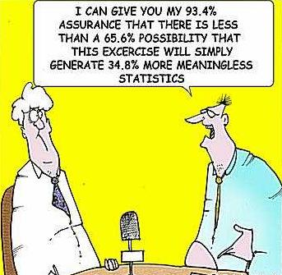

Slide 74
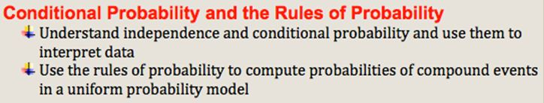
SAMPLE PROBABILITY STANDARD

Slide 75
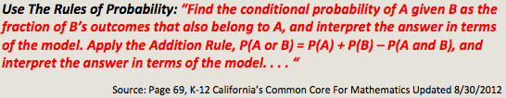
SAMPLE PROBABILITY STANDARD

Slide 76
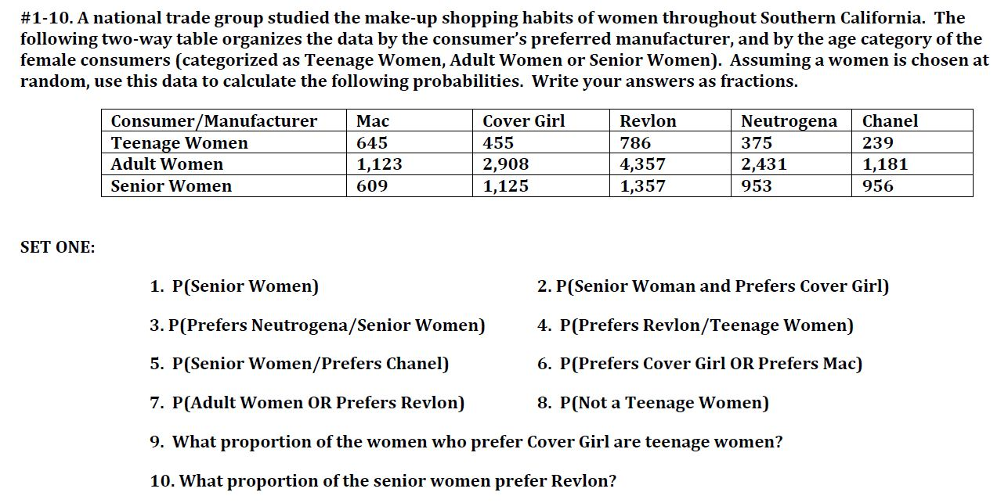
Copy In Your Package

Slide 77

EXCEL
&
Grid Power
DESIGNING INSTRUCTION: Quick & Clean
Notes:
More Slides Like This One We Need. “Differentiated Instruction With EXCEL”; “Assessment With Excel”; “Modeling With Excel”; “Functions With Excel”; “Graphic Organizers With Excel”; Maybe use different colors besides red.

Slide 78
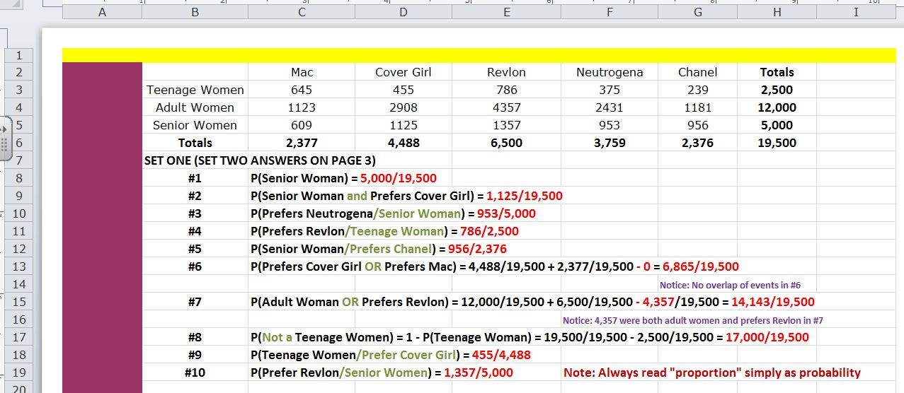
PROCTORING: Color Coded Worksheet Limits Cheating
Notes:
Here speed and alignment of answers are more easily organized in Excel.
Annotated answer worksheets can be created with Excel. These worksheets allow students to self-assess their work outside the classroom. The ability of students to open formula windows and observe cell contents allow them to delve deeply in the calculations. Color coding of concepts and instructional elements are easily incorporated.
To avoid students accessing inappropriate materials during assessments, worksheets with gaudy borders are created and posted on the website. Students must remain on the assigned worksheet until the test is completed. From the back of the room, these borders are easily visible. Any non-conforming screens are a red flag that students may be cheating.
Excel allows entire rows or columns can be highlighted which connects well with the concept of conditional probability in a data table context. Students can visually observe the reduced size of the sample set imposed by a “given” condition. Substantial improvement was documented when instruction included this strategy.

Slide 79

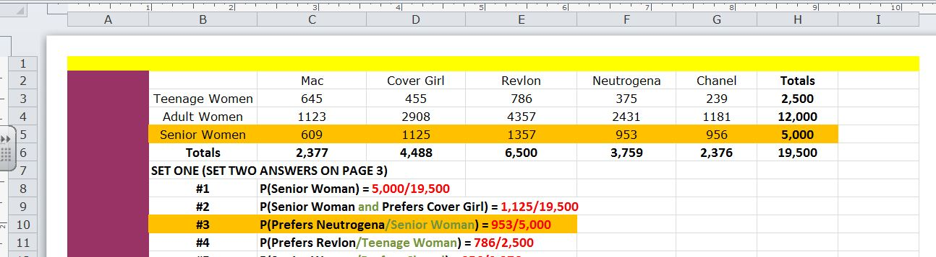
HIGHLIGHT ROWS: Limited Sample Set You Can See

Slide 80

EXCEL
&
Graphic Organizers
GRAPHIC ORGANIZERS TO THE RESCUE!
Notes:
More Slides Like This One We Need. “Differentiated Instruction With EXCEL”; “Assessment With Excel”; “Modeling With Excel”; “Functions With Excel”; “Graphic Organizers With Excel”; Maybe use different colors besides red.

Slide 81
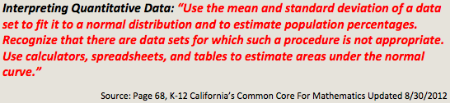
SAMPLE PROBABILITY STANDARD

Slide 82
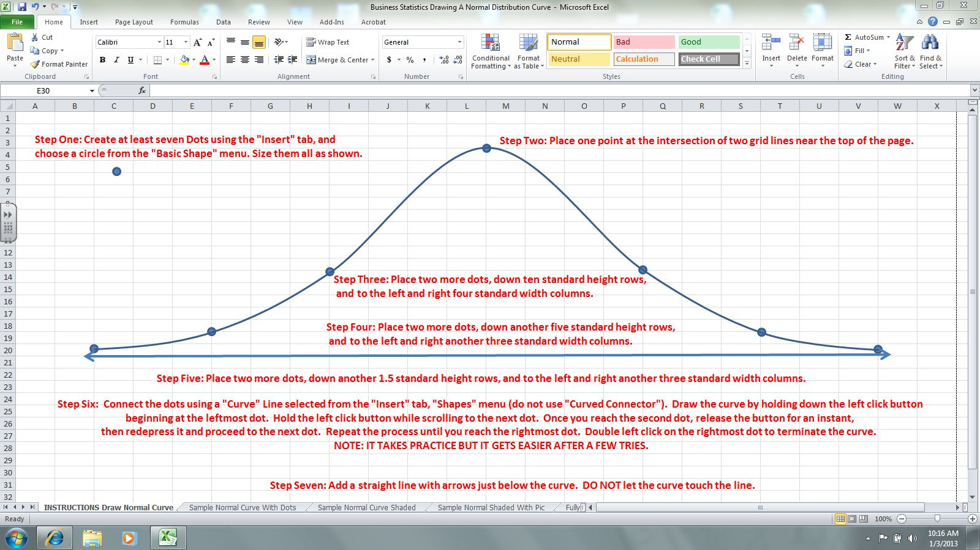
NORMAL CURVE LESSON: Copy In Your Package
DRAW NORMAL CURVE:
Sequenced Instruction
Notes:
The next series of slides will progress quickly, and is intended to show how instruction can be organized using EXCEL. If you’re interested in more details of the lesson itself, you have been provided PDF copies of each worksheet that comprise the lesson.

Slide 83
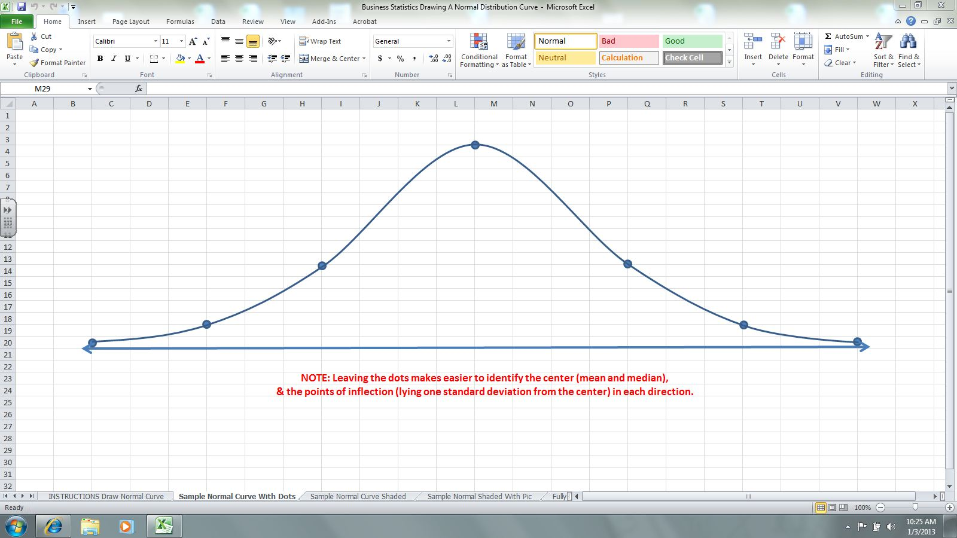
PROGRESS SNAPSHOT:
Compare Work To Sample

Slide 84
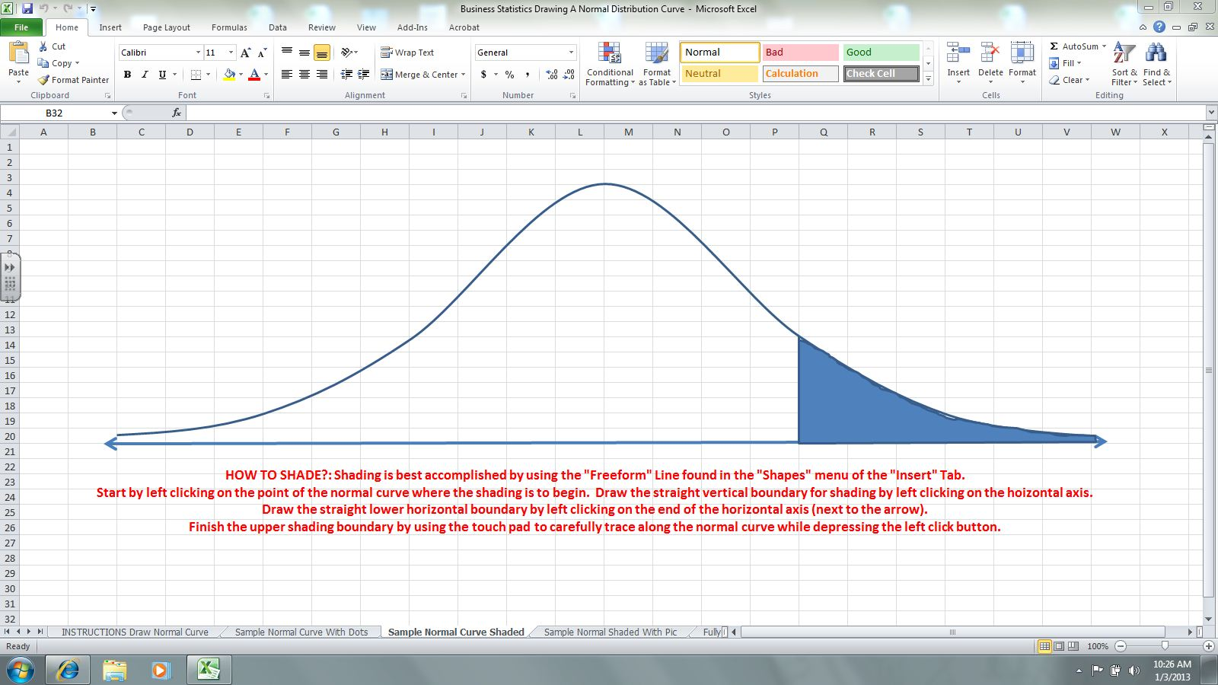
INSTRUCTION PROCEEDS:
Shading The Probability Region

Slide 85
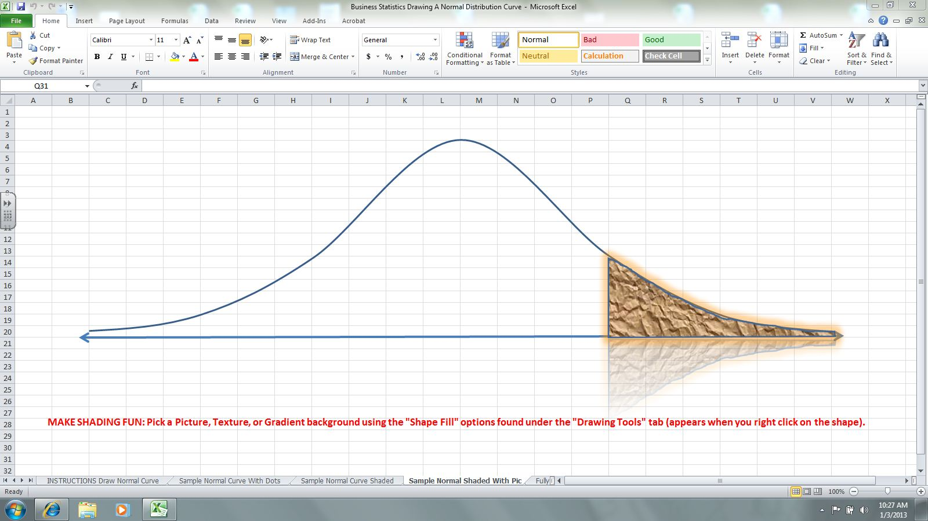
INTEGRATE ART:
Students Enjoy Personalizing Their Work
Notes:
These artistic embellishments will generally take only 20%-30% of the total time spent on the project. Most of the time is spent on math. Plus the integration of art in an EXCEL spreadsheet is a marketable skill, and the end product becomes part of their EXCEL portfolio.

Slide 86
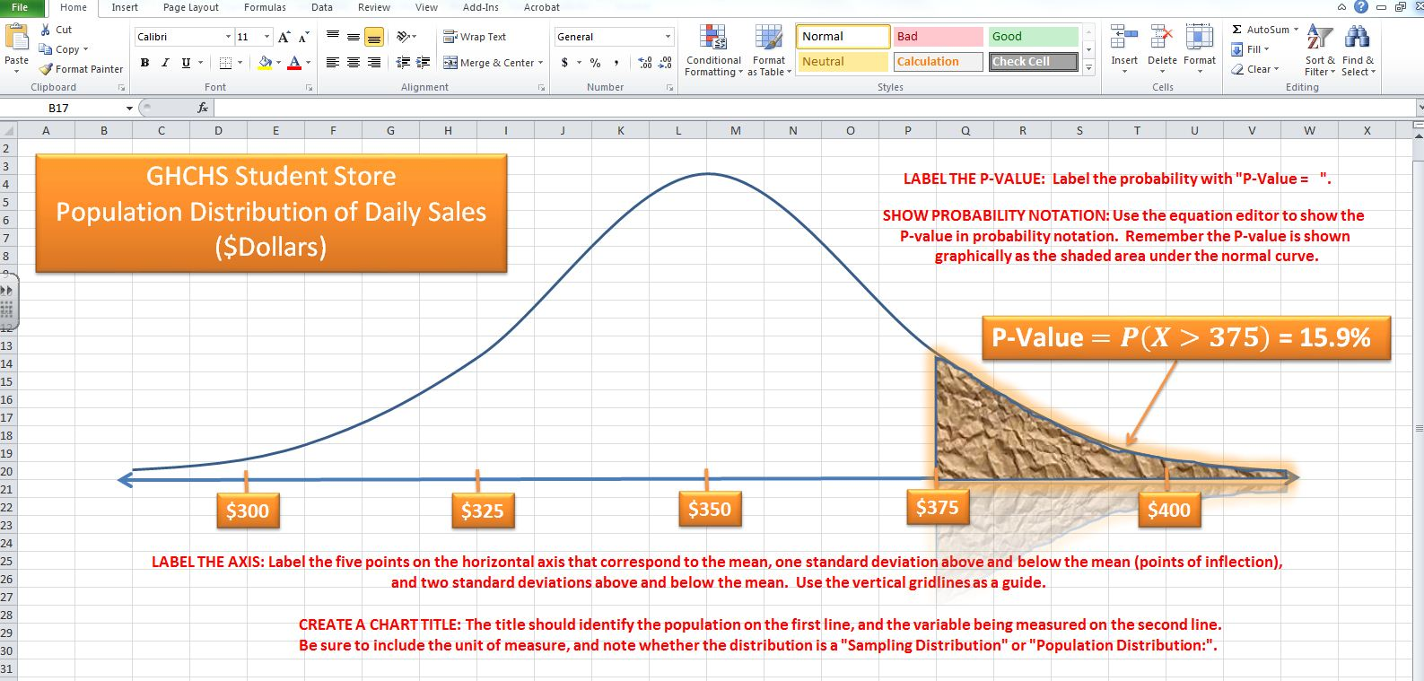
FOCUS ATTENTION:
Students Highlight Key Elements of Normal Distribution.
Notes:
Here the student labels the horizontal axis showing an understanding of spread, and the unique characteristic of normal curves

Slide 87


Notes:
Input examples of student work here.

Slide 88

EXCEL
&
Assessment
EXCEL GRAPHICS: An Alternative Assessment
Notes:
More Slides Like This One We Need. “Differentiated Instruction With EXCEL”; “Assessment With Excel”; “Modeling With Excel”; “Functions With Excel”; “Graphic Organizers With Excel”; Maybe use different colors besides red.

Slide 89
CENTER: Mean Of Normal Distribution
Notes:
CENTER

Slide 90
SHAPE: Symmetric Normal Curve Approaches
But Does Not Touch The Horizontal Axis
Notes:
SHAPE

Slide 91
SPREAD: Axis Labels Show Inflection Points Lie One Standard Deviation From Center
Notes:
SPREAD

Slide 92
PROBABILITY FROM NORMAL CURVES:
Students Demonstrate Understanding In 3 Contexts
* Graphically as a shaded portion of normal curve;
* Abstractly using probability notation; and
* Quantitatively using Excel functions to find %.
Notes:
Input examples of student work here.

Slide 93

STUDENT WORK

Slide 94

STUDENT WORK
INTRODUCING SAMPLING DISTRIBUTIONS:
Going Beyond The Standard

Slide 95

EXCEL
&
“LINKED” INSTRUCTION
EXCEL HYPERLINK FEATURE:
Control The Cognitive Process
Notes:
More Slides Like This One We Need. “Differentiated Instruction With EXCEL”; “Assessment With Excel”; “Modeling With Excel”; “Functions With Excel”; “Graphic Organizers With Excel”; Maybe use different colors besides red.

Slide 96

INFERENCE DOMAIN

Slide 97

WORKSHEET TABS:
Organize Instructional Resources

Slide 98

EXCEL HYPERLINKS:
Supplement & Review Instruction
Link #1
Link #2

Slide 99

LINK #1: Students Review Inference Components
Craft Links To Control Cognitive Development
Notes:
Notice when the student uses return link, it puts them back to the exact same place they left the body of the main lesson. I believe this keeps students focused and the organization helps their metacognitive absorption of the lesson.

Slide 100

Efficient Navigation Within A Lesson
Leads To
EFFICIENT LEARNING
LINK #2:

Slide 101

EXCEL
&
MODELING
Notes:
More Slides Like This One We Need. “Differentiated Instruction With EXCEL”; “Assessment With Excel”; “Modeling With Excel”; “Functions With Excel”; “Graphic Organizers With Excel”; Maybe use different colors besides red.

Slide 102


Slide 103

A PHd Degree In A Single Window
A REAL GAME CHANGER!

Slide 104

FUNCTIONS GALORE
Notes:
Notice EXCEL allows students to model more than the Common Core required linear, exponential, and quadratic functions.

Slide 105
EXCEL
IN
ENGLISH
Notes:
Notice how Excel can be effective graphic displays as graphic organizers in an English class. First take a look at an example of two graphic organizers provided to me in a recent seminar on Common Core English. These quick sketches serve a purpose no doubt but greater clarity is gained from the preparation of an Excel graphic display. Relativity of comparisons must be quantified. I envision these structures could be used at a pre-write stage, an intermediary stage to review a draft, or as a post-write alternative communication or as a supplemental graphic to accompany an oral and written presentation.

Slide 106

Pre-Write Activity:
Sorting Out Themes & Their Relative Importance
STUDENT WORK
Notes:
Notice here student identified setting, key scenes from the text, and key concepts of the etxt.

Slide 107

STUDENT WORK
Reading Comprehension Activity:
Pinpointing Literary Elements In Two Texts
Notes:
Here the student extracts quotes from

Slide 108

Quantification Activity:
Contrasting Traits Of Two Characters
STUDENT WORK

Slide 109

STUDENT WORK
Note Taking:
Tracking Theme Through Text Citations

Slide 110

STUDENT WORK

Slide 111

STUDENT WORK

Slide 112

STUDENT WORK

Slide 113

STUDENT WORK

Slide 114

STUDENT WORK

Slide 115
EXCELlent Instructional Strategies
Common Core Math & Financial Literacy
More Real World In What We Teach!
Thank You For Your Time !
FOR MORE INFO: businessstatistics.us
OR CONTACT ME: annelson@ghchs.com

Slide 116

CPA Presentation

Slide 117
FINANCIAL LITERACY STANDARDS
LEGISLATIVE TRENDS: Link & Text In Your Package
. . . Financial literacy focuses on the specific knowledge and concepts consumers need to know to manage their money and build wealth, depending on an individual’s situation. It may mean learning how to create and manage a household budget, learning how to invest money for retirement,. . . .

